Slide 1
CIS 4930/6930-002 Data Visualization
Matching Game!
Paul Rosen
Assistant Professor
University of South Florida
.

Slide 2
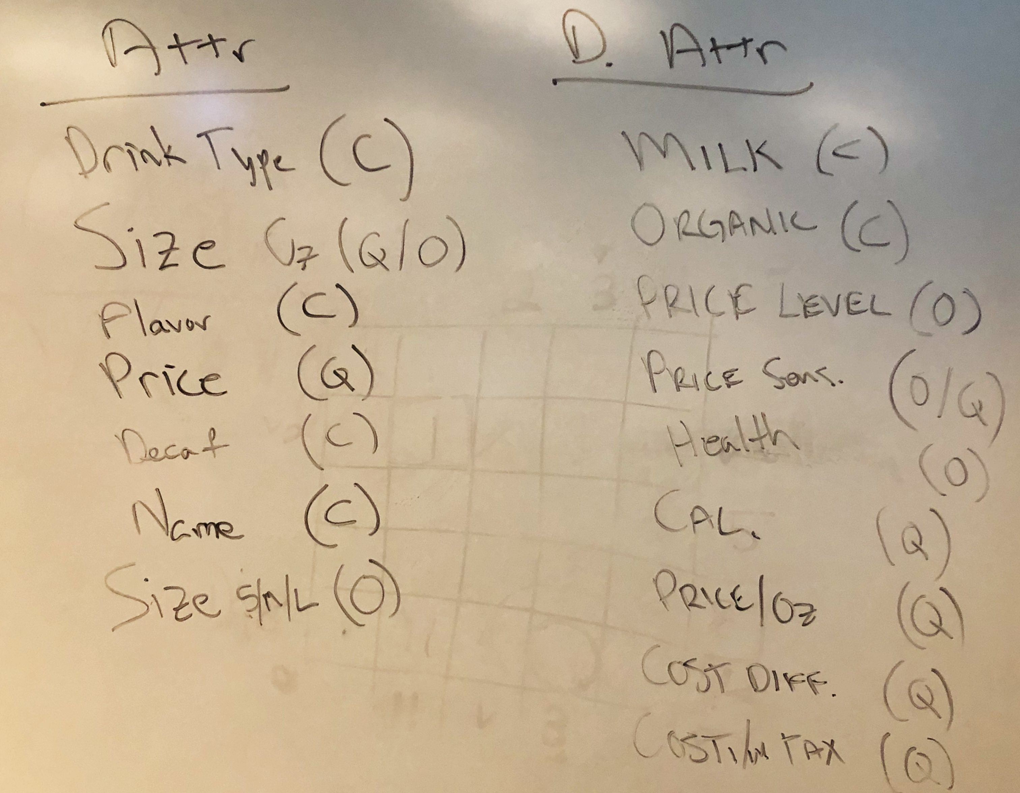
Match our data abstraction. . .

Slide 3

…To my visualization
Guatemala
Guatemala
Sumatra
Espresso
Americano
Latte
Cappuccino
Mocha
Organic Breakfast
Organic Green
Chai
Chai Latte
Black Latte
Hot Chocolate
Determine marks (0D, 1D, 2D) and visual encoding channels (position, color, shape, etc.) used
Make some observations using the data

